Slide 1






Foundations of
Quantum Information Science (QIS 101)
Dave Biersach
Brookhaven National Laboratory
dbiersach@bnl.gov
Session 24
Quantum Algorithms

Slide 2
Session 24 – Goals
Review the Kronecker product of vectors and how to boost the tensor rank of a vector to be that of a matrix
How to manipulate a qubit's phase using quantum gates
Consider the value of phase encoding of pure states
Analyze the phenomenon of phase kickback between entangled qubits
Appreciate how qubits enable superdense coding
Implement the Deutsch Oracle using Qiskit
Mathematically trace the Deutsch algorithm
Implement the Deutsch-Jozsa Oracle using matrices

Slide 3
Session 24 – Goals
Understand how Grover's Algorithm leverages phase amplification to increase the probability that a wave function will collapse to a meaningful state

Slide 4
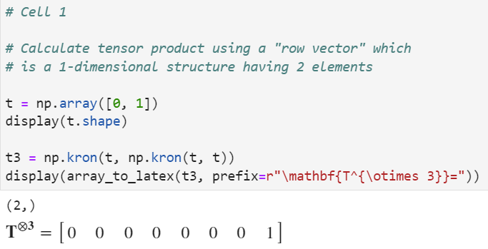
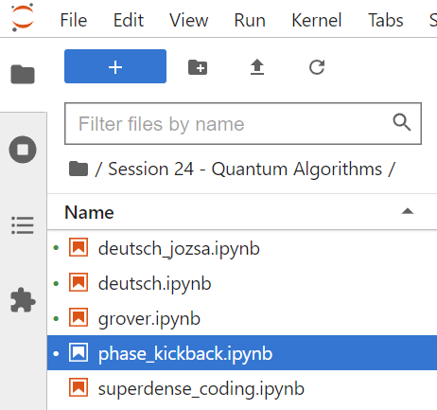
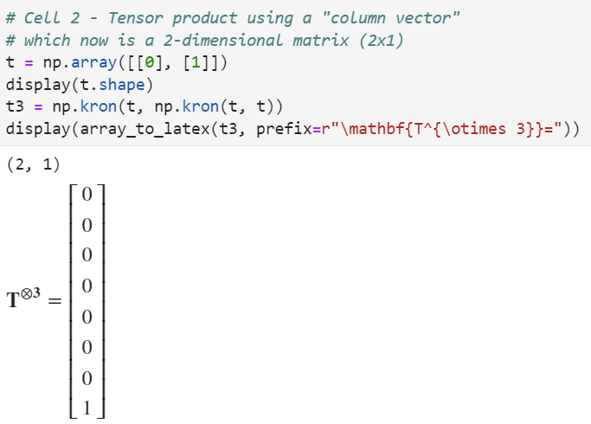
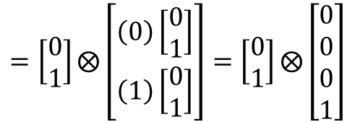
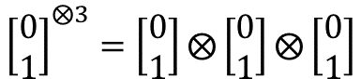
Run Cell 1 & 2 phase_kickback.ipynb
①
②
④
③
⑤
⑥
⑦
⑨
⑧
$${\left[\begin{matrix}0 \\ 1\end{matrix}\right]}^{⨂3}=\left[\begin{matrix}0 \\ 1\end{matrix}\right]⨂\left[\begin{matrix}0 \\ 1\end{matrix}\right]⨂\left[\begin{matrix}0 \\ 1\end{matrix}\right]$$
$$=\left[\begin{matrix}0 \\ 1\end{matrix}\right]⨂\left[\begin{matrix}\left(0\right)\left[\begin{matrix}0 \\ 1\end{matrix}\right] \\ \left(1\right)\left[\begin{matrix}0 \\ 1\end{matrix}\right]\end{matrix}\right]=\left[\begin{matrix}0 \\ 1\end{matrix}\right]⨂\left[\begin{matrix}0 \\ 0 \\ 0 \\ 1\end{matrix}\right]$$
⑩

Slide 5
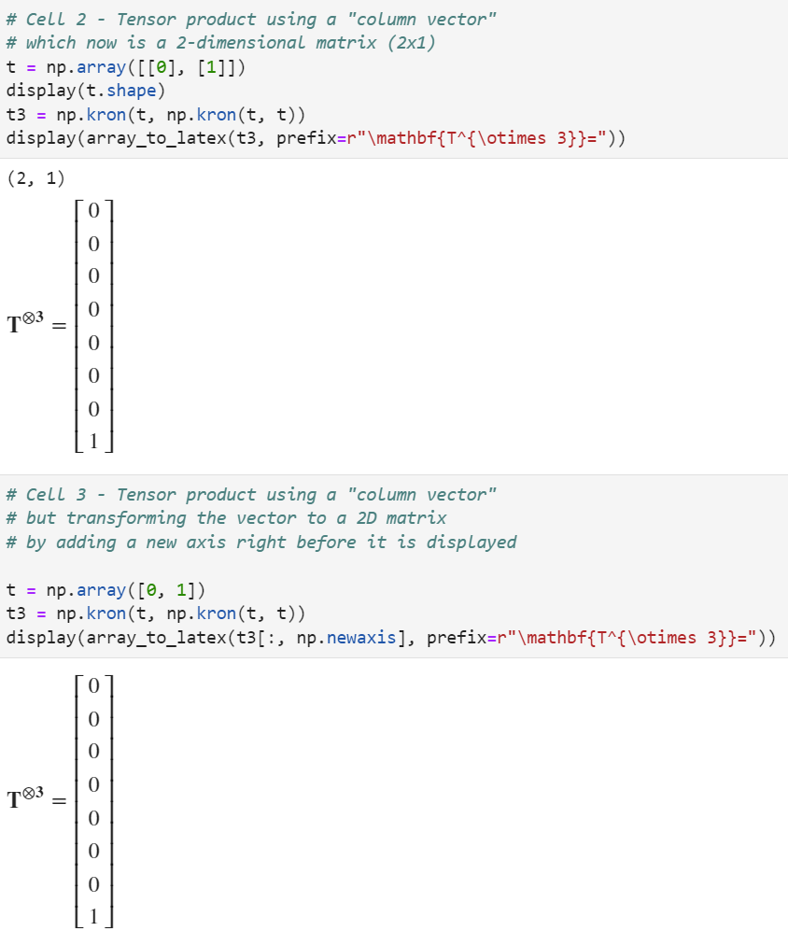

Run Cell 3 phase_kickback.ipynb
$${\left[\begin{matrix}0 \\ 1\end{matrix}\right]}^{⨂3}=\left[\begin{matrix}0 \\ 1\end{matrix}\right]⨂\left[\begin{matrix}0 \\ 1\end{matrix}\right]⨂\left[\begin{matrix}0 \\ 1\end{matrix}\right]$$
①
②
③
④

Slide 6
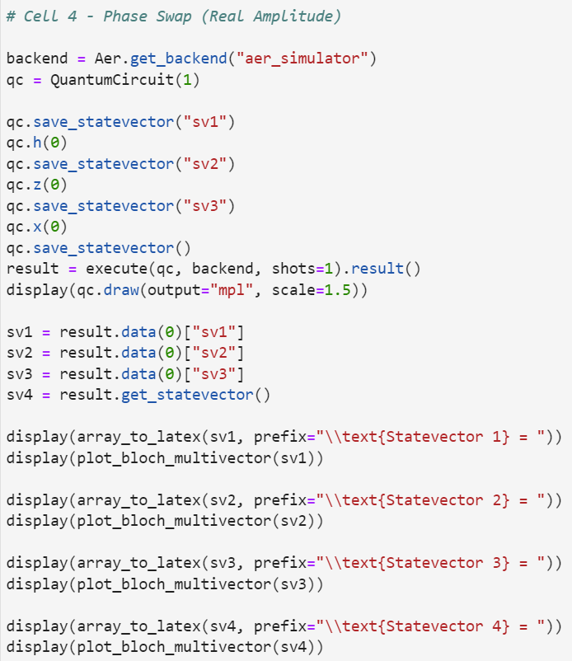
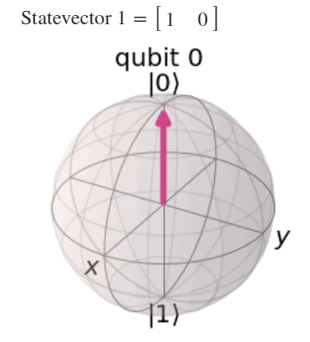
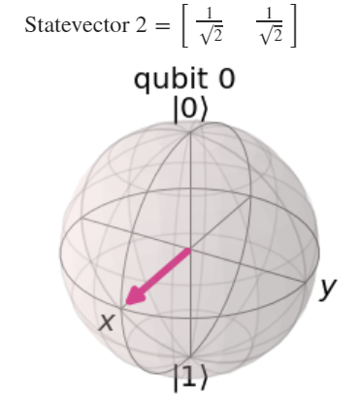
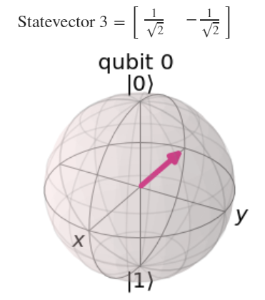

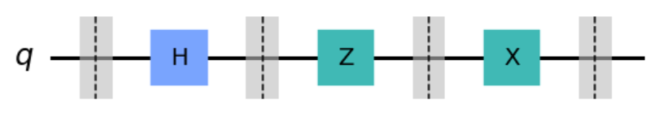
①
Run Cell 4 phase_kickback.ipynb
②
③
④
⑤
⑥

Slide 7
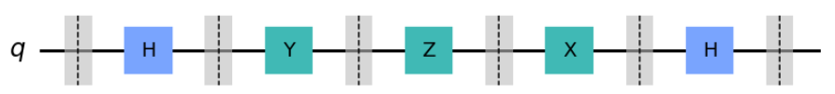
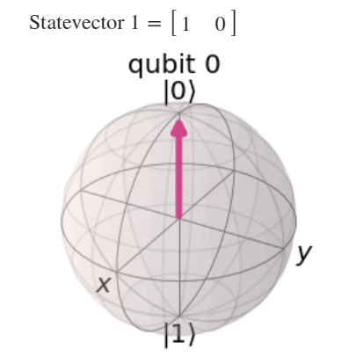
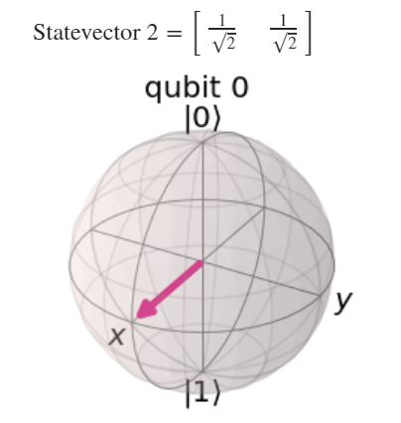
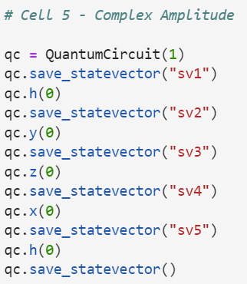
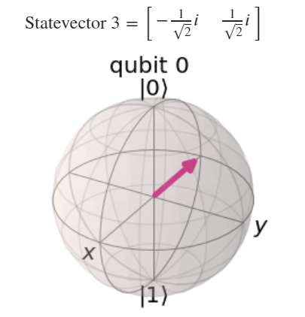
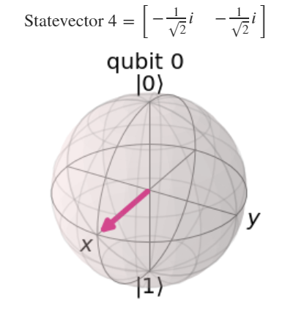
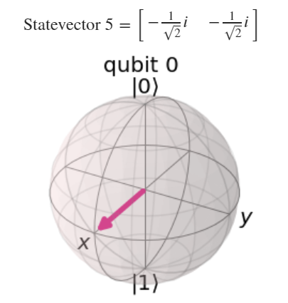
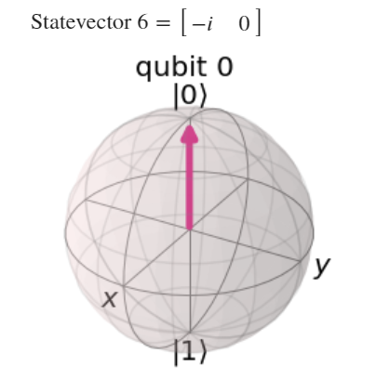


Run Cell 5
①
②
③
④
⑤
⑥

Slide 8
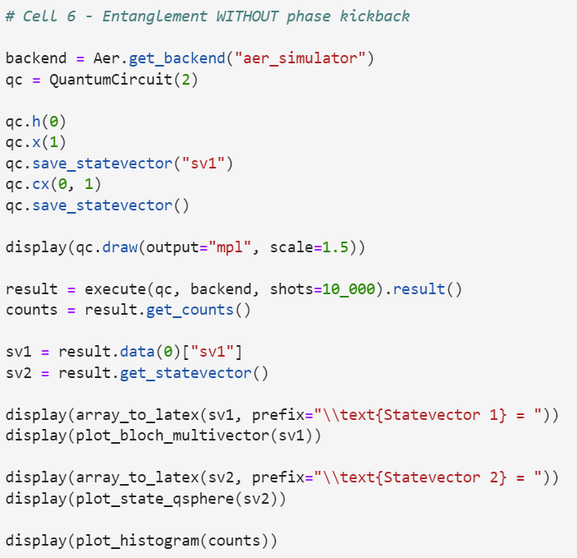
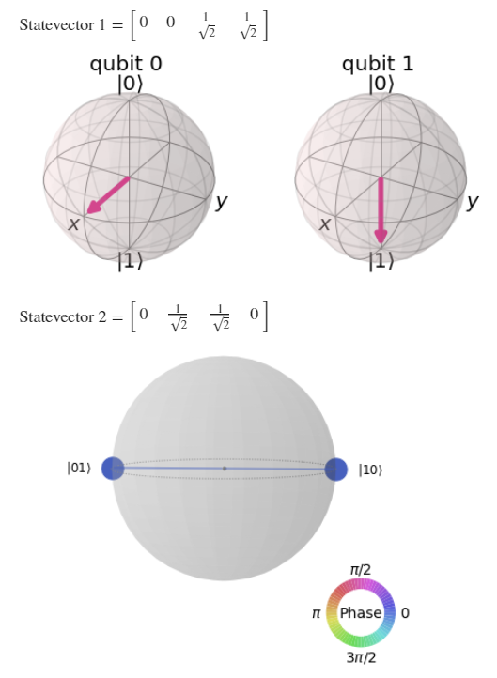
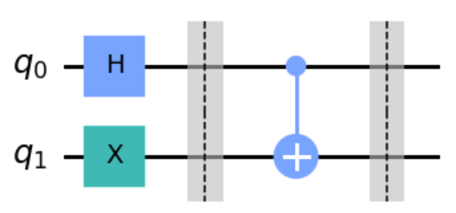
Run Cell 6
①
②

Slide 9
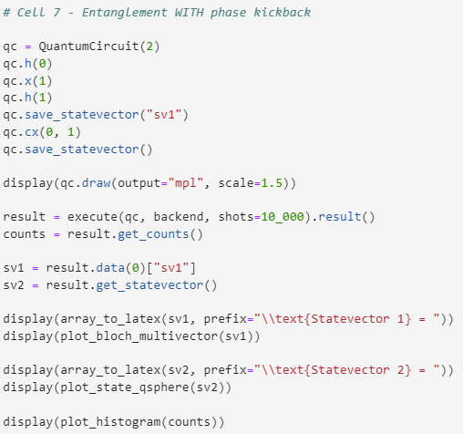
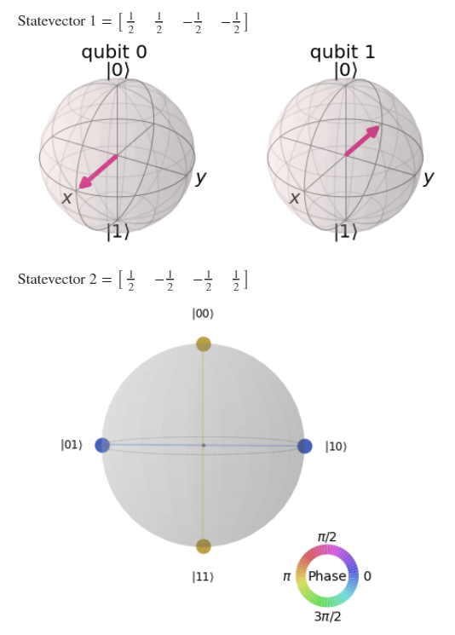
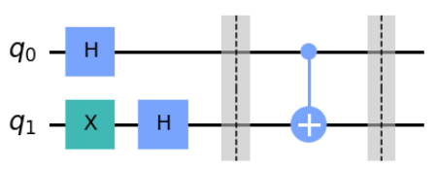
Run Cell 7
①
②

Slide 10


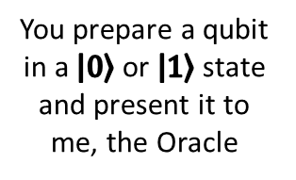
The Deutsch Oracle
You are the traveler
I am the wise Oracle
There are four possible secret functions - only the Oracle knows which one is being used
NOP – I don't change your qubit (no operation), then I measure it, and I return the classical bit value to which it collapses
Constant 0 – No matter how your qubit collapses, I always give back a classical bit in the 0 state
You prepare a qubit in a $\left|\left.0\right\rangle \right.$ or $\left|\left.1\right\rangle \right.$state and present it to me, the Oracle
Based upon your qubit and my secret function, I give you back a single classical bit
(a pure True or False)
Constant 1 – No matter how your qubit collapses, I always give back a classical bit in the 1 state
NOT – I first invert (X Gate) your qubit, then I measure it, and I return the classical bit value to which it collapses
Functions 1 & 4 are the "Balanced" functions
Functions 2 & 3 are the "Constant" functions

Slide 11
The Deutsch Oracle
You are the traveler
I am the wise Oracle
There are four possible secret functions - only the Oracle knows which one is being used
NOP – I don't change your qubit (no operation), then I measure it, and I return the classical bit value to which it collapses
Constant 0 – No matter how your qubit collapses, I always give back a classical bit in the 0 state
You prepare a qubit in a $\left|\left.0\right\rangle \right.$ or $\left|\left.1\right\rangle \right.$state and present it to me, the Oracle
Based upon your qubit and my secret function, I give you back a single classical bit
(a pure True or False)
Constant 1 – No matter how your qubit collapses, I always give back a classical bit in the 1 state
NOT – I first invert (X Gate) your qubit, then I measure it, and I return the classical bit value to which it collapses
How many trips to the Oracle must you make
to know for sure if the secret function
is Constant or Balanced ?

Slide 12
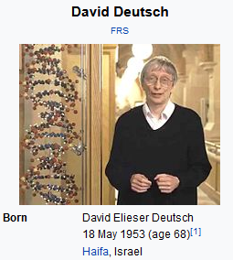
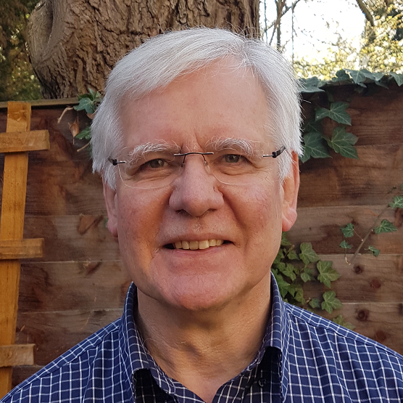
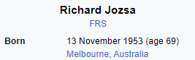
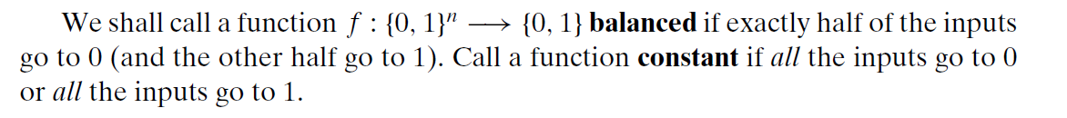
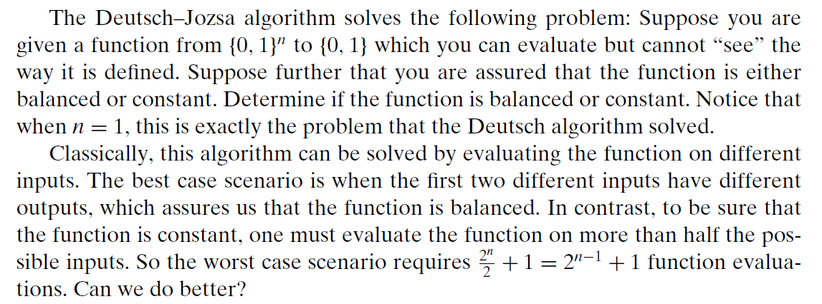
Deutsch-Jozsa Algorithm

Slide 13
Quantum Supremacy
The Deutsch-Jozsa algorithm demonstrates quantum supremacy because no classical computer can outperform this quantum circuit
Deutsch's 1985 paper described an Oracle with a single input, but in 1992, he (along with Richard Jozsa) expanded the algorithm to include any number of inputs
With four possible secret functions: no operation (NOP), constant 0, constant 1, and inverse (NOT), at least two trips to the Oracle would be required to discover which of the four possible functions was being used
But Deutsch changes the basis: the 1st question becomes "constant or balanced?" and the 2nd question would be "which type of constant or balanced" …but we don't have to ask that 2nd question!

Slide 14
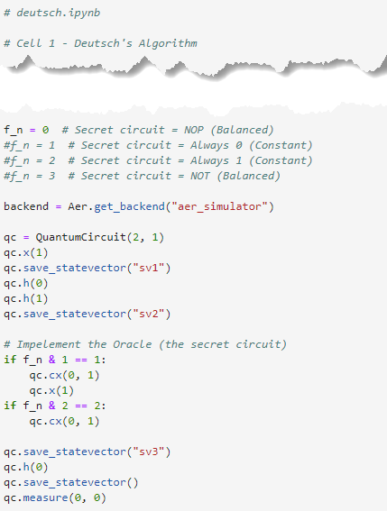
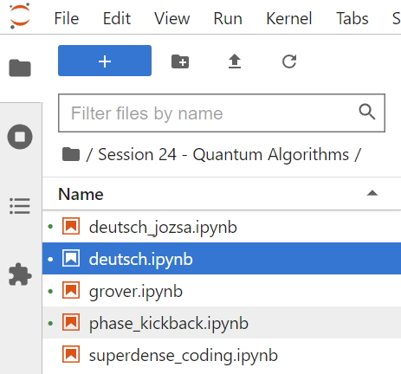
Open Cell 1 deutsch.ipynb
①
②
③
④
⑤

Slide 15
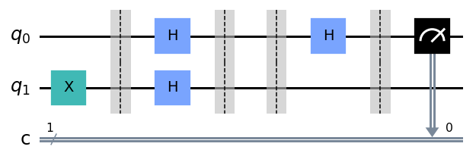
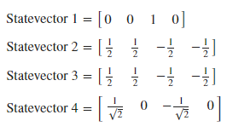
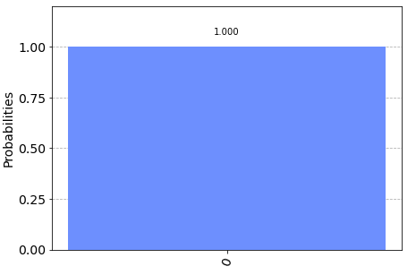
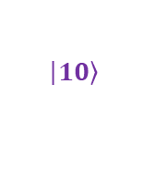

Run Cell 1 deutsch.ipynb
①
With f_n = 0
②
③
④
$$\left|\left.00\right\rangle \right.$$
$$\left|\left.10\right\rangle \right.$$
⑤

Slide 16
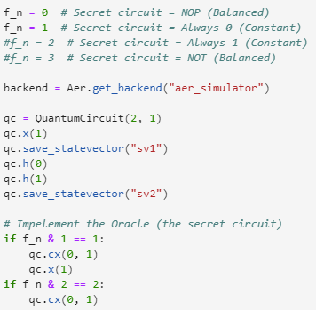
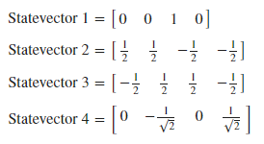
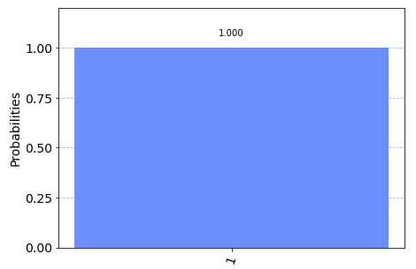
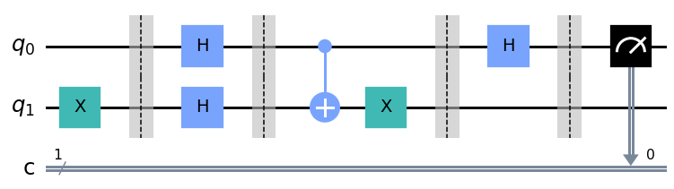


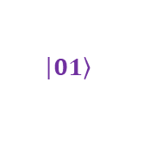
Edit Cell 1 deutsch.ipynb
①
If we present a qubit in superposition to the Oracle,
if a 0 is returned,
the secret function is Balanced
if a 1 is returned,
the secret function is Constant
$$\left|\left.01\right\rangle \right.$$
$$\left|\left.11\right\rangle \right.$$
②
The Secret Oracle

Slide 17
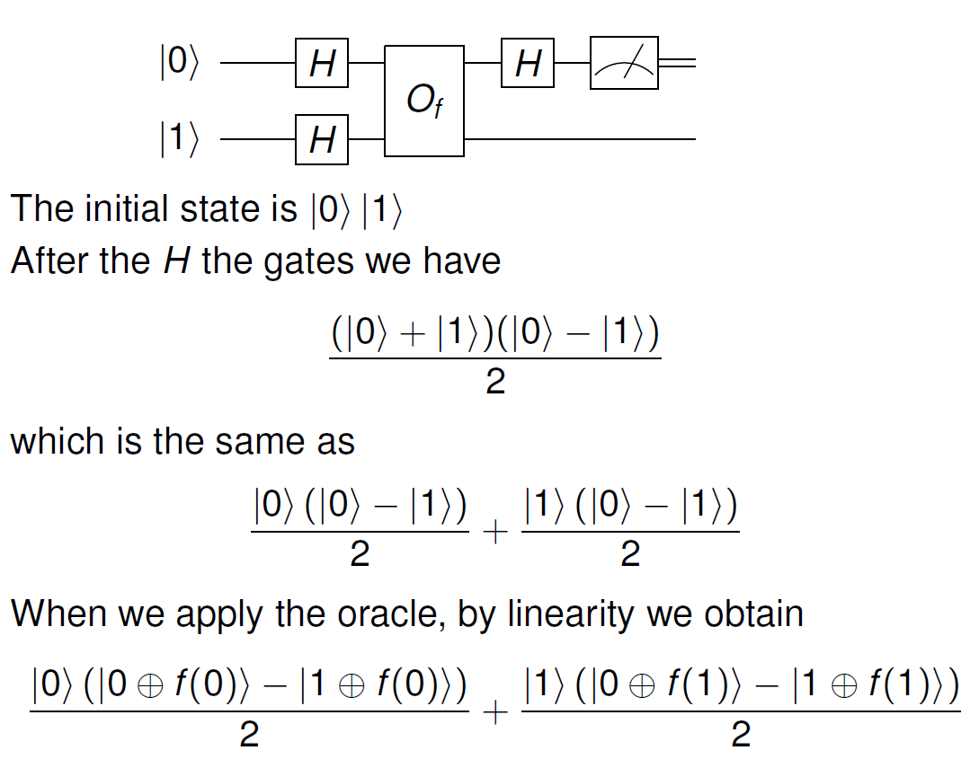
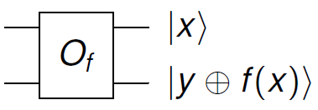
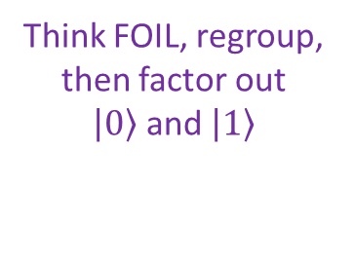
Deutsch's Algorithm – The Math
Think FOIL, regroup, then factor out
$\left|\left.0\right\rangle \right.$ and $\left|\left.1\right\rangle \right.$

Slide 18
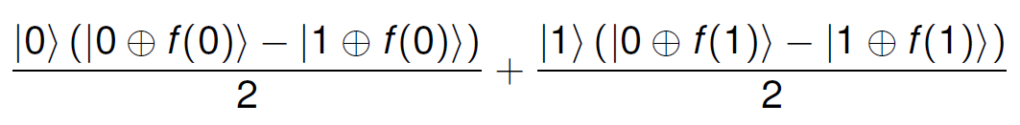
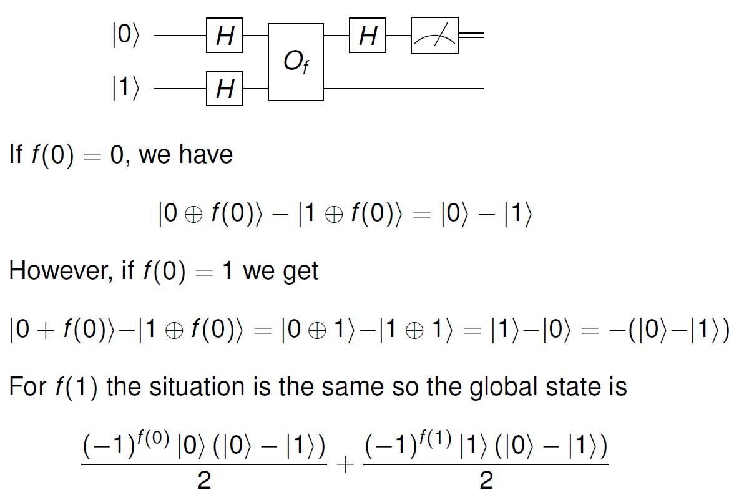
Deutsch's Algorithm – The Math

Slide 19
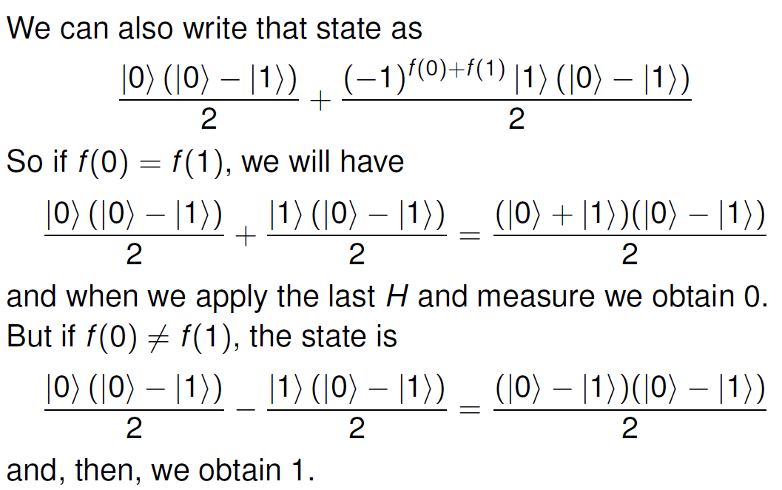
Deutsch's Algorithm – The Math

Slide 20
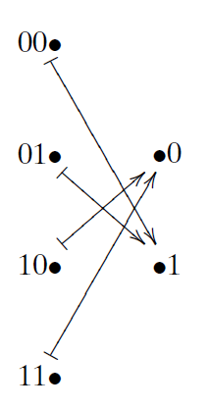
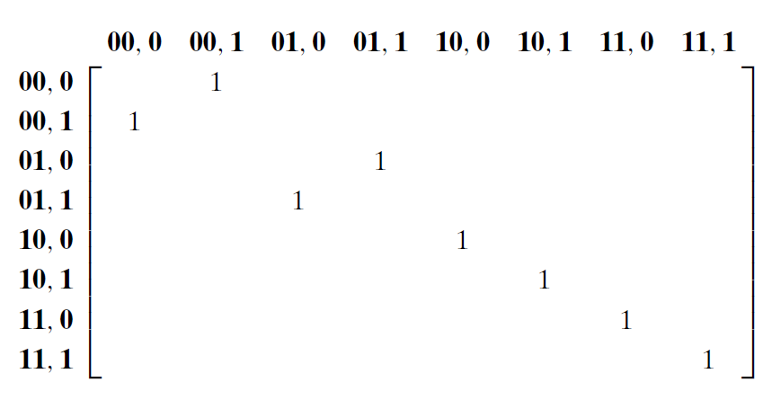





The Deutsch-Jozsa Oracle (Two Inputs)
Inputs:
x is a two-qubit register
y is a single qubit
Consider the following
balanced function
The Secret Function
$$x$$
$$f(x)$$
$$x$$
$$y$$
$$x$$
$$y^{′}$$
We don't know this matrix as $f\left(x\right)$ is the secret we are trying to discover!
$$y^{′}=f(x)⊕y$$

Slide 21




A Quantum Algorithm as a Matrix
x
g1
y
g2
g3
t1
t2
g4
Assume n = 2 as our secret function maps two input bits to a single bit
Only a constant function will produce a $\left.|ψ\right\rangle$ of $\left[x,0,0,0,0,0,0,0\right]$

Slide 22



Open Cell 1 deutsch_jozsa.ipynb
①
②
③
⑥
⑦
⑧
⑨
⑩
④
⑤

Slide 23


Run Cells 1-4 deutsch_Jozsa.ipynb
①
②
③
④

Slide 24

The Deutsch-Jozsa Oracle
On a quantum computer, we can answer the question whether the hidden function is balanced or constant in just one step
This is exponential speed-up over the provably optimal classical algorithm which requires (on average) $2^{n−1}+1$ steps for a function with $n$ inputs
This is an admittedly contrived problem, but it shows the potential for a quantum computer to outperform classical algorithms that were proven "optimal"
It is also noteworthy that to learn the fundamentals of quantum computing you only need to know a little Python, a few things about matrices, and a feel for complex numbers

Slide 25

The Deutsch-Jozsa Oracle
https://qiskit.org/textbook/ch-algorithms/deutsch-jozsa.html

Slide 26






Grover's Algorithm
Finding the Winner
Avg. Case = N / 2
Worst Case = N
N = 3
map to
= $5_{10}$

Slide 27

Grover's Algorithm
Ancilla qubit

Slide 28



Grover's Algorithm
Initialization
$$\left|\left.s\right\rangle \right.$$
The Oracle decrees (encodes) which state is the winner
A CZ gate (with two input qubits) marks the winner to be at location 3
The current mean amplitude

Slide 29

Grover's Algorithm
Initialization
$$\left|\left.s\right\rangle \right.$$
The Oracle decrees (encodes) which state is the winner
A CZ gate (with two input qubits) marks the winner to be at location 3
The new mean amplitude

Slide 30

Grover's Algorithm
Initialization
$$\left|\left.s\right\rangle \right.$$
The Oracle decrees (encodes) which state is the winner
A CZ gate (with two input qubits) marks the winner to be at location 3
We have amplified the amplitude of the winning state!
The new mean amplitude

Slide 31

Grover's Algorithm
Yes, we need to know the location of the winner ahead of time in order to construct the Oracle's unitary matrix – so we cannot magically use Grover's algorithm on classical (non-quantum) databases

Slide 32



Run Cell 1 grover.ipynb
①

Slide 33



Run Cell 2 grover.ipynb
①
②
③
⑤
④
⑥
⑦
⑧
⑨
⑩

Slide 34




①
Run Cells 3 & 4 grover.ipynb
②
③
④
⑤
⑥
⑦
⑧
⑩

Slide 35





①
Run Cells 5 & 6 grover.ipynb
②
③
④
⑤
⑥
⑦
⑧

Slide 36
Why Quantum Programming Is Hard
Programmers must think in terms of operators (unitary matrices) and reversibility (ancilla bits, uncomputation)
Entanglement is hard to track mentally and even harder to visualize - but therein lies the true power of quantum computing
Physical device limitations (# qubits, # shots, noise)
If you cannot first understand the algorithm mathematically, it will be difficult to implement it correctly on a quantum computer
Phase kickback, amplitude amplification, and the Quantum Fourier Transform (QFT) are the current building blocks of most quantum algorithms – learn these techniques!

Slide 37

Session 24 – Now You Know
Vectors are 1-dimensional constructs, they have no transpose
To conform to the rules of standard matrix multiplication, or to use array display functions, we may have to boost a vector's dimensions to be a row or column 2-D matrix
Numpy supports Python's array slicing syntax and can add a pseudo row/column using np.newaxis
The numpy.dot() operator gracefully handles the multiplication of scalars, vectors, and matrices
A qubit's phase onto itself does not affect its probability of a $\left|\left.0\right\rangle \right.$ or $\left|\left.1\right\rangle \right.$but will affect the outcome of a Hadamard gate

Slide 38
Session 24 – Now You Know
When the phase of a target qubit in a controlled gate affects the phase of the control qubit it is called phase kickback and can only happen between entangled qubits
The Deutsch Oracle is a trivial algorithm, but was one of the first to demonstrate (but not prove) quantum supremacy
If you cannot step-by-step explain a quantum algorithm using raw state vectors, brackets, tensors, unitary matrices, and matrix multiplication, then you don't really understand the algorithm – it is not magic – it is linear algebra
The phase amplification used in Grover's Algorithm leverages increases the probability that a wave function will collapse to a meaningful state

